Slide 1
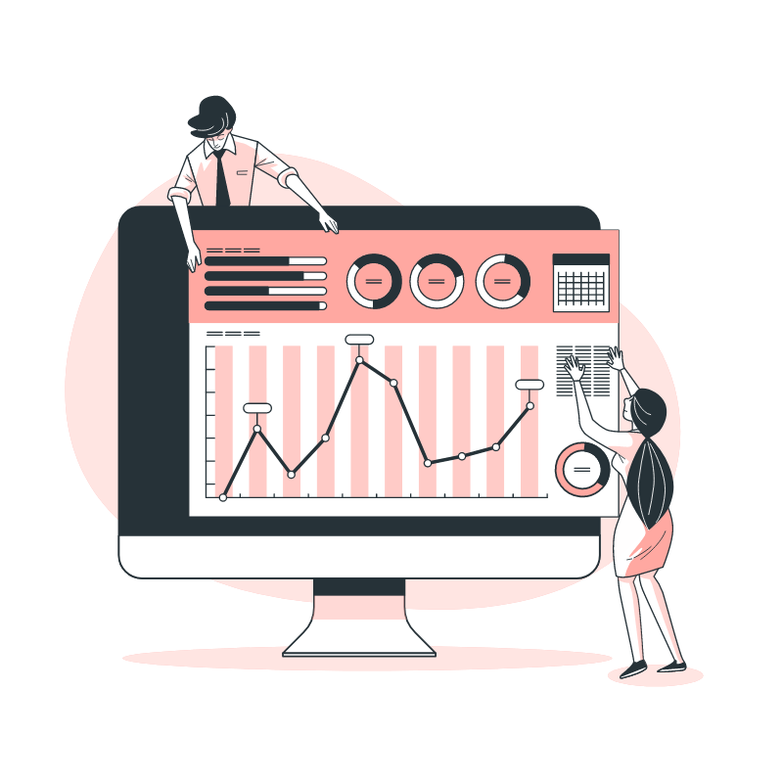
HTU- Point of Sale
By
Abdulrahman Hasan

Slide 2

Problem Statement
HTU established a store inside King Abdullah Business Park. The IMU in HTU recruited me to build a Point of Sale (POS) web application to handle the store sales transactions and stock. There are many employees with a different role that will work on the POS. The admin of the POS system wants to see a quick information of the total sales and transactions in addition to the stock of each item.

Slide 3

What is POS system
Before presenting the solution or before talking about the proposed system, we must have a look at what the POS system is, its uses and advantages.
A point of sale, refers to the ‘point’ where a customer makes a purchase and the payment is processed.
In the past, a 'POS system' used to refer to the cash register at a store. Today, modern POS systems are entirely digital, which means you can check your business wherever you are.
Process sales and service transactions should be done properly, old systems (Cash register system) have many disadvantages like errors in recording, the calculation is less precise, and the speed in service is low. And since we are in technology era (time) we have to find a modern, economic, effective, accurate, fast, convenient solution, Which is the –HTU-POS web application- my project today.

Slide 4

Here comes the role of our web Application HTU-POS

Slide 5

Project Goals
Help business owners on making business decisions by keep them able to access the system even once they are at home or traveling. No matter where you are, you’ll always have the information you need to. And I achieved that by deploy the system (Project) on a live server.
To provide a user friendly interface which allows any user, regardless of his level of knowledge of technology, to understand the web application without facing difficulties.
Provide Stocks Processes (Add/delete/update) and selling functionalities in a simple, organized, and Secure steps.

Slide 6
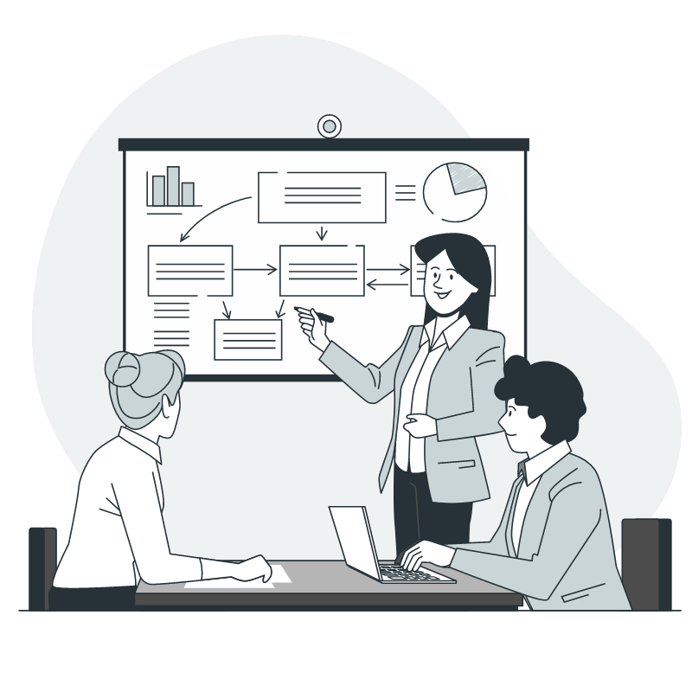
Requirements Analysis
There will be five main pages (views) with different sub pages in this system:
1- Admin informative dashboard.
2- Users management page.
3- Selling dashboard.
4- Stocks management page.
5- Transactions management page.

Slide 7
Requirements Analysis
Also, There will be four main system users with different privileges to access these pages:
1- Administrator: can access all previous pages.
2- Seller: can access only selling dashboard.
3- Procurement manager: can access only stock management page.
4- Accountant: can only access Transactions management page.

Slide 8

System Features and (GUIs)

Slide 9
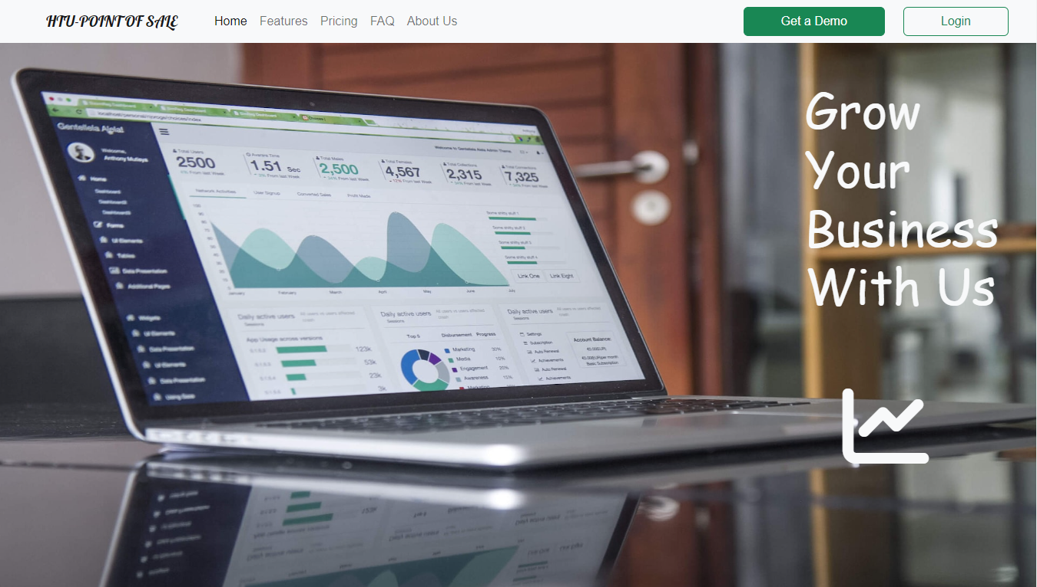
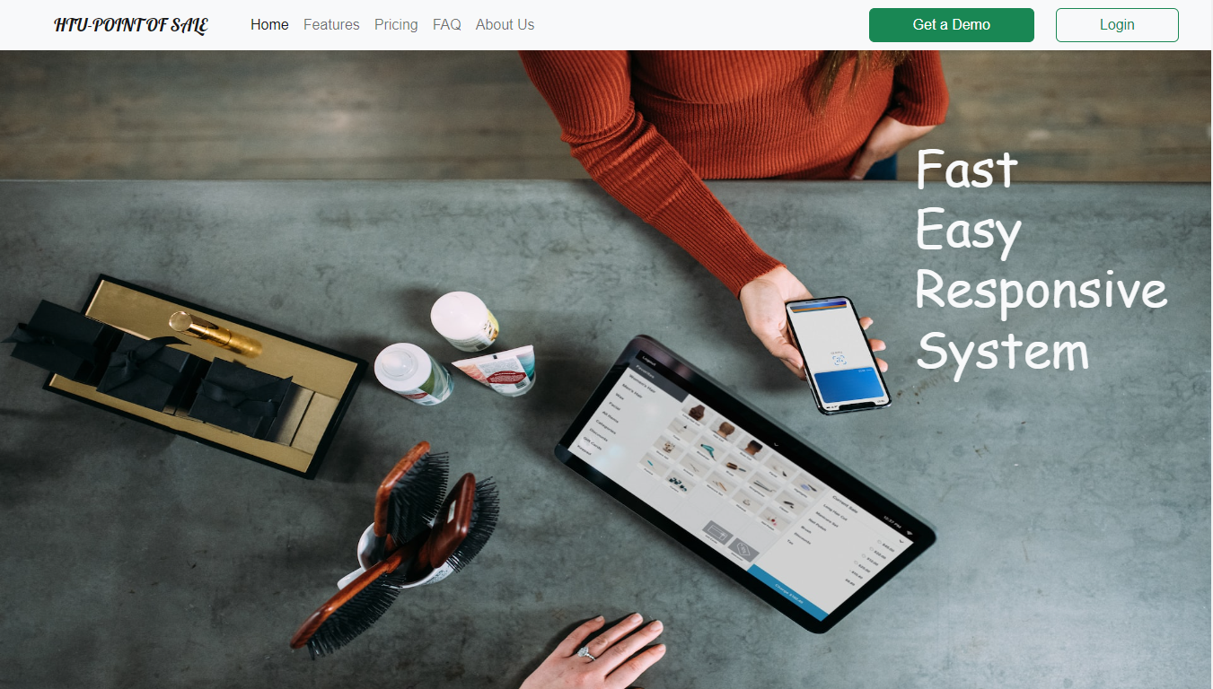
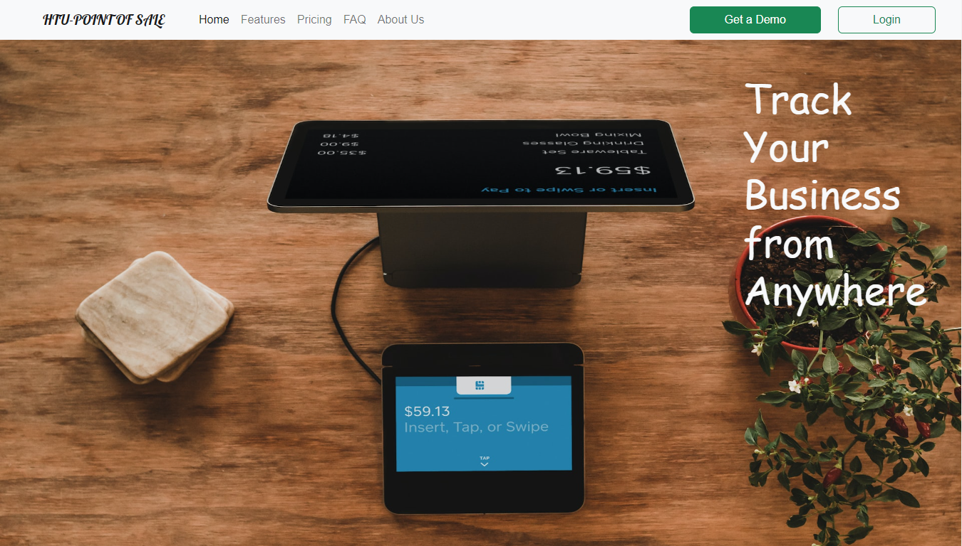
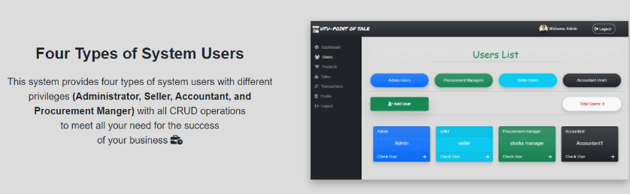
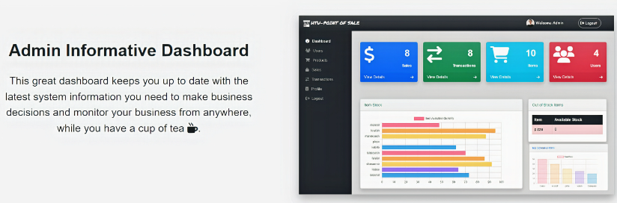
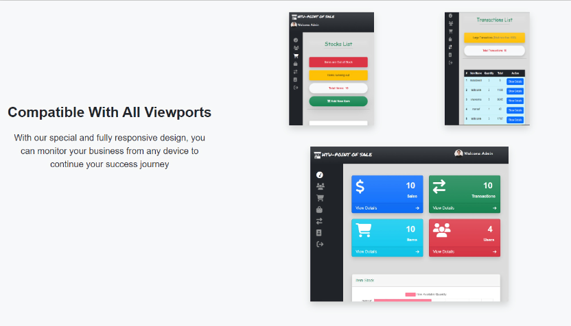
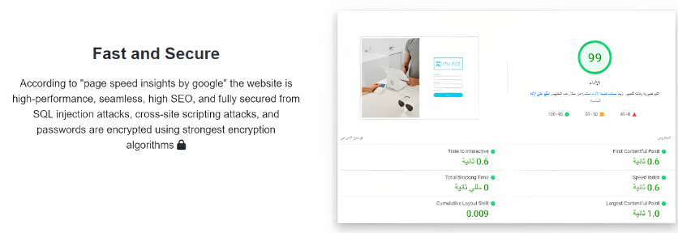
Home Page (GUI)
Notes:
As we can see here this is the home page or the landing page which contains a brief about the main features in this web app with pages snapshots and by the way this page is an additional page it’s not in the SSR file (one of the requirements), I have made this page to be an informational page about the web application.

Slide 10
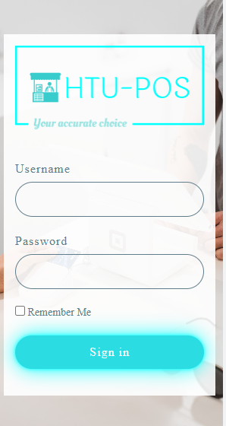


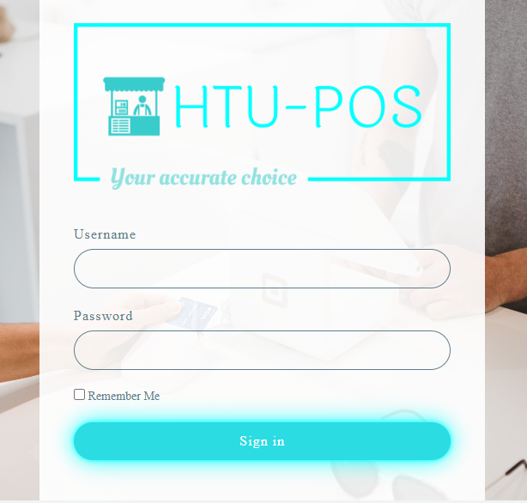
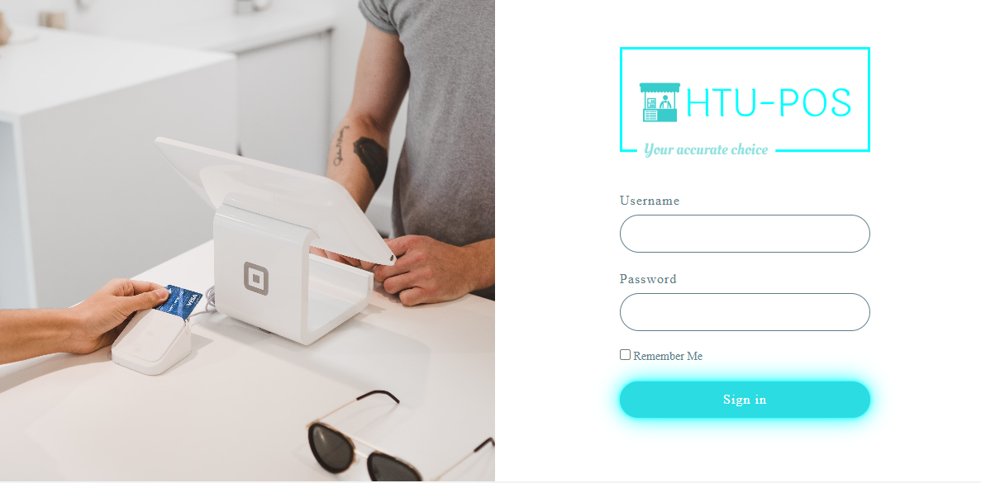
Login Page (GUI)
Notes:
Here is the login page of my web application all the design using css and its responsive, Also it’s secure Nobody can know the password except the logged in user using haching alogrithms in addition to the front-end and backend validation.

Slide 11
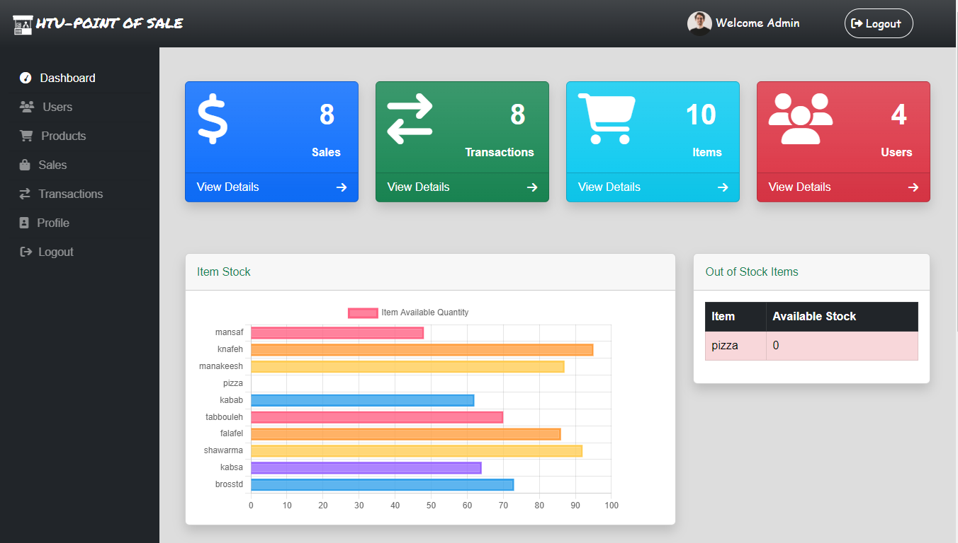
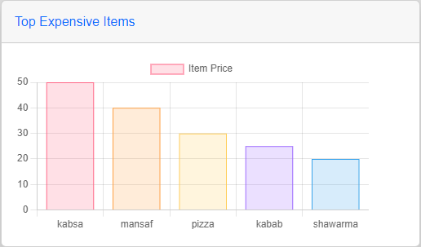
Admin Dashboard (GUI)
Admin Dashboard
Notes:
Admin dashboard contain the following information: Total sales, Total transactions, Total items number, Total users, chart represents top five expensive items to buy, chart represents items available quantity, and table of items out of stock.

Slide 12
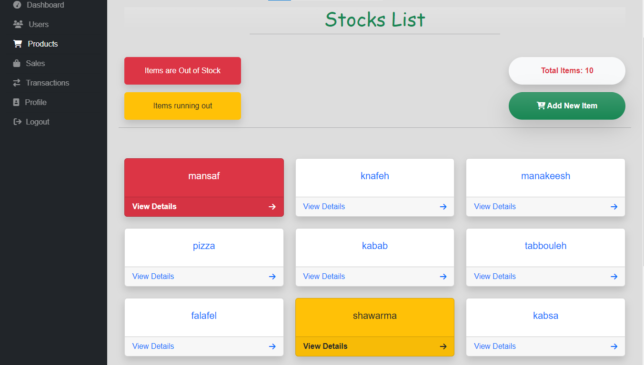
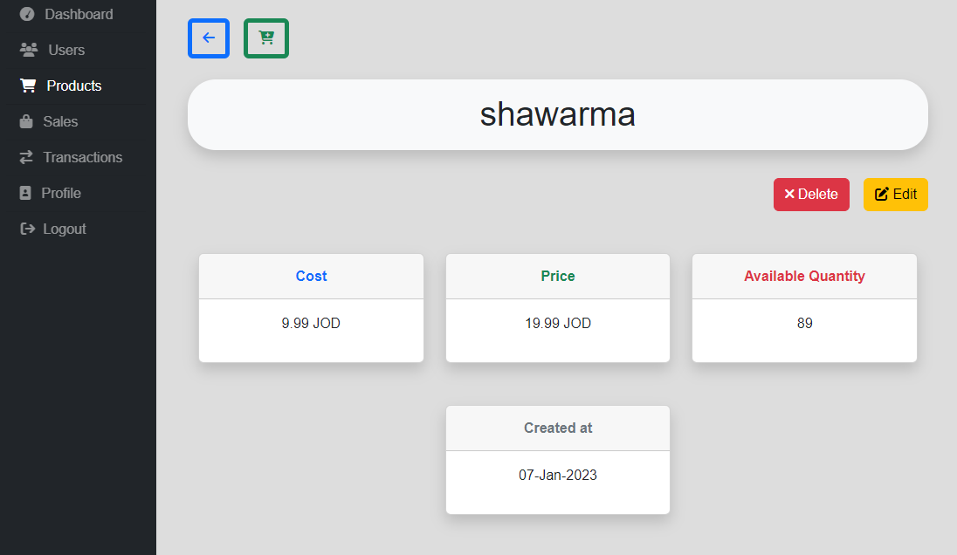
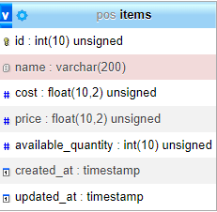
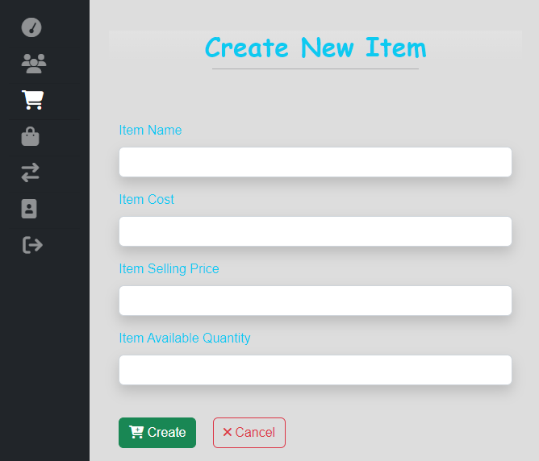
Stocks management page (GUI)
Item details
Items list page
Item attributes
Create new Item page
Notes:
Here is the items or products pages the procurement manger can access these page to check all items, add new items to the inventory or update delete item. Each item has … (columns, fields, attributes )in the db

Slide 13
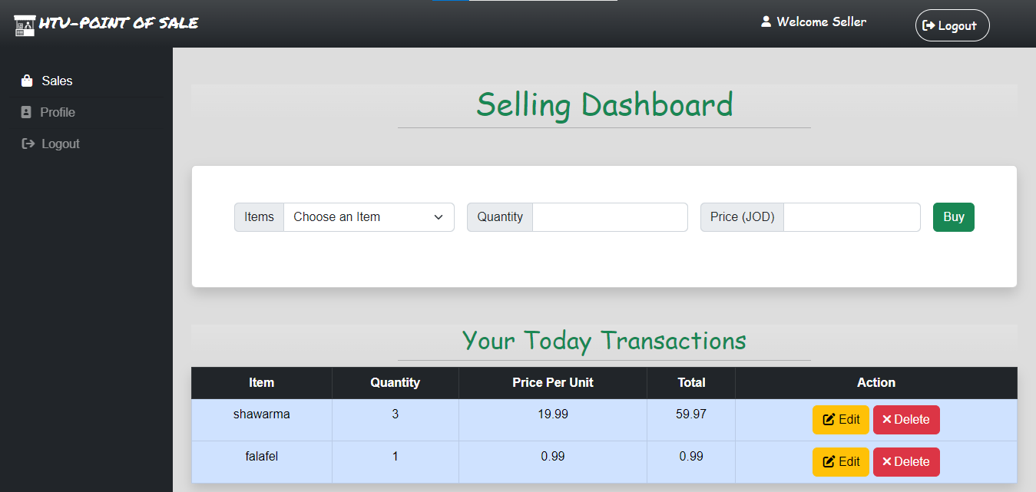
Selling Dashboard (GUI)
Selling Dashboard
Notes:
This is the selling dashboard each time a customer buys a product or service, they’re completing a point of sale transaction. This is the moment when you officially make a sale. A digital or printed receipt is created, and you ship or hand your customer the items they’ve just bought. this page is developed using AJAX and have an API to support the AJAX requests. contains selling form with item name and item quantity. The seller can’t sell items that is out of stock. There is a list in the same page for all the transactions that has been made today by the current logged in user. The seller can edit or delete each transaction on this list directly using action buttons.

Slide 14
Selling Dashboard Important Note!
Here In Selling dashboard we have to pay attention to an important mathematical equations between tow tables transactions and items. To make the selling process organized, synchronized, and accurate.
when we want to make a new transaction (selling products):
Item available quantity (in Items table) = Item full available quantity - sold (wanted) item quantity in this transaction.
when we want to update a transaction by increasing or decreasing quantities:
Item full available quantity (in Items table) = The remaining quantity of this item (in Items table) + sold item quantity in this transaction ± updated (new desired) quantity .
when we want to delete a transaction.
Item full available quantity (in Items table) = The remaining quantity of this item (in Items table) + sold item quantity in this transaction.

Slide 15
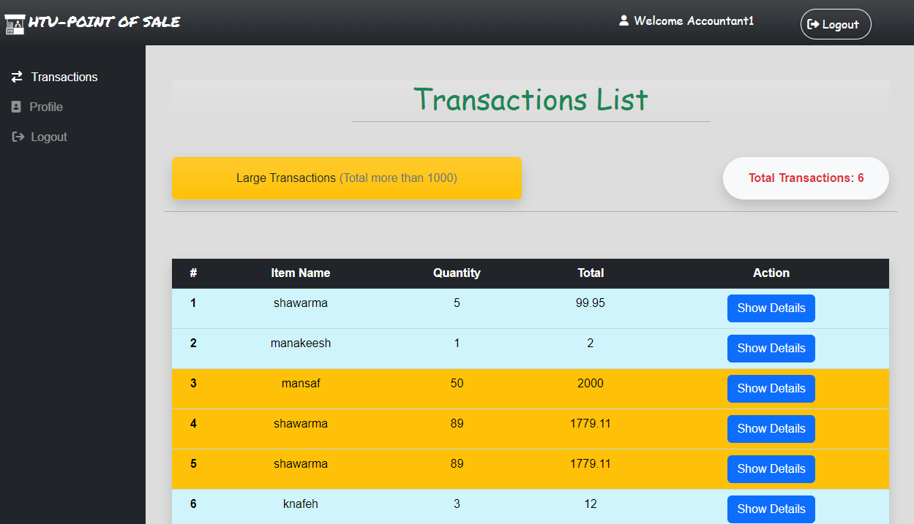
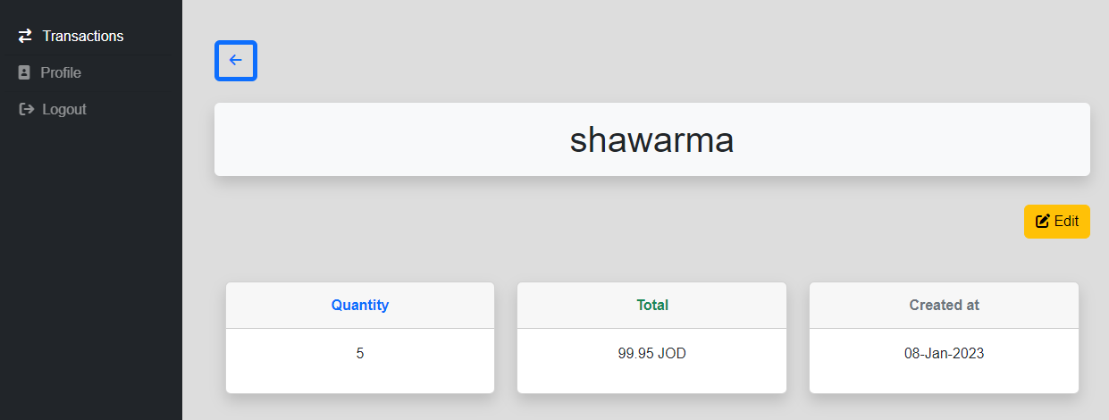
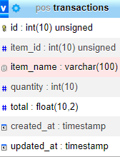
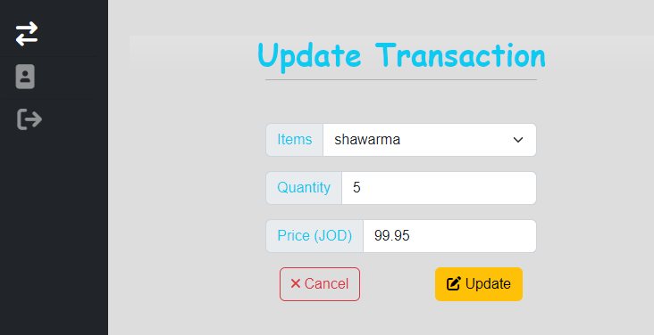
Transactions management pages (GUI)
Single transaction details
All transactions page
Transaction attributes
Update transaction page
Notes:
As we can see here this is the transaction management page Just a reminder each time a customer purchase a product or service, they’re completing a point of sale transaction. The Accountant user can access this page to check all transactions or update a specific transaction .

Slide 16
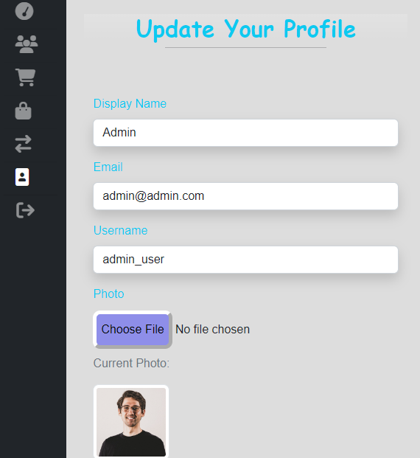
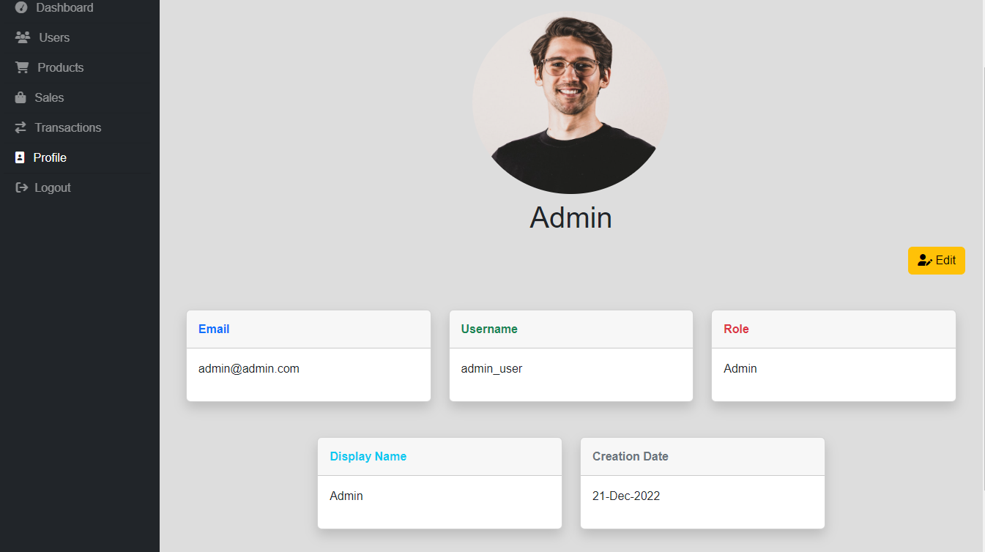

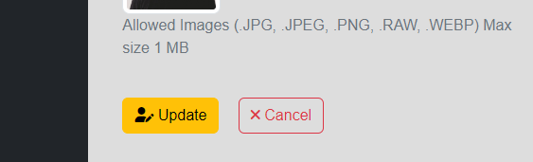
Profile page (GUI)
User profile page
Update profile info
Notes:
this is the Profile page for each user which contains user info (email, username, role, display name, creation_date) all users can access this page and update their profile info (display name, email, user name, and uploading a profile photo if they want).

Slide 17
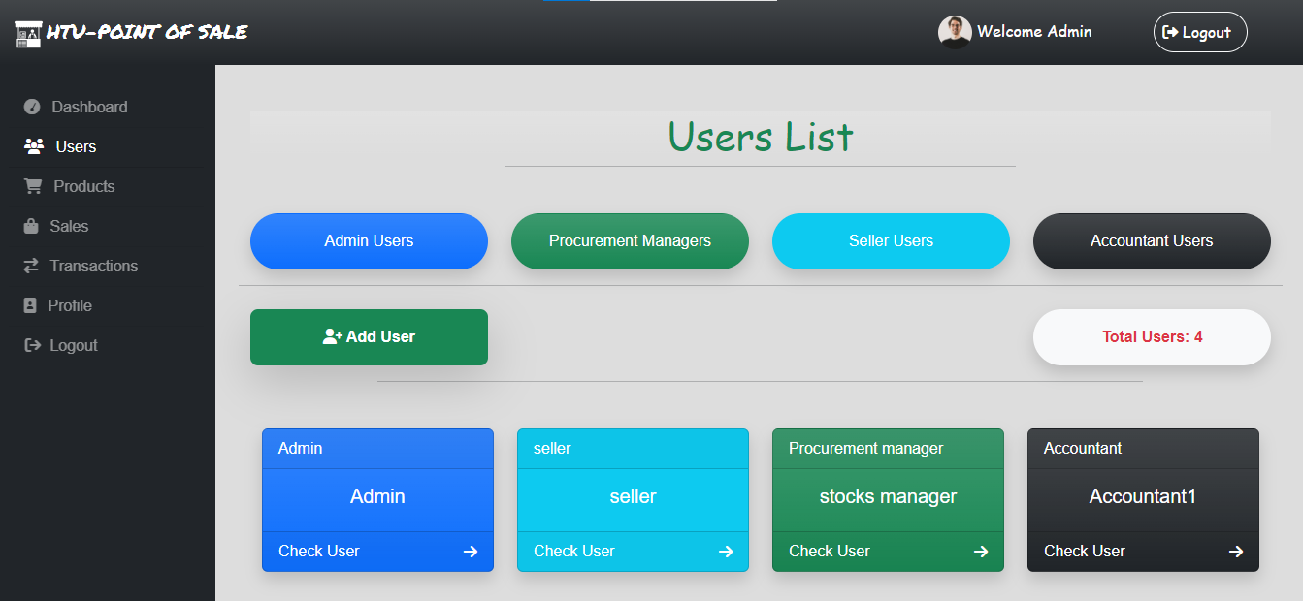
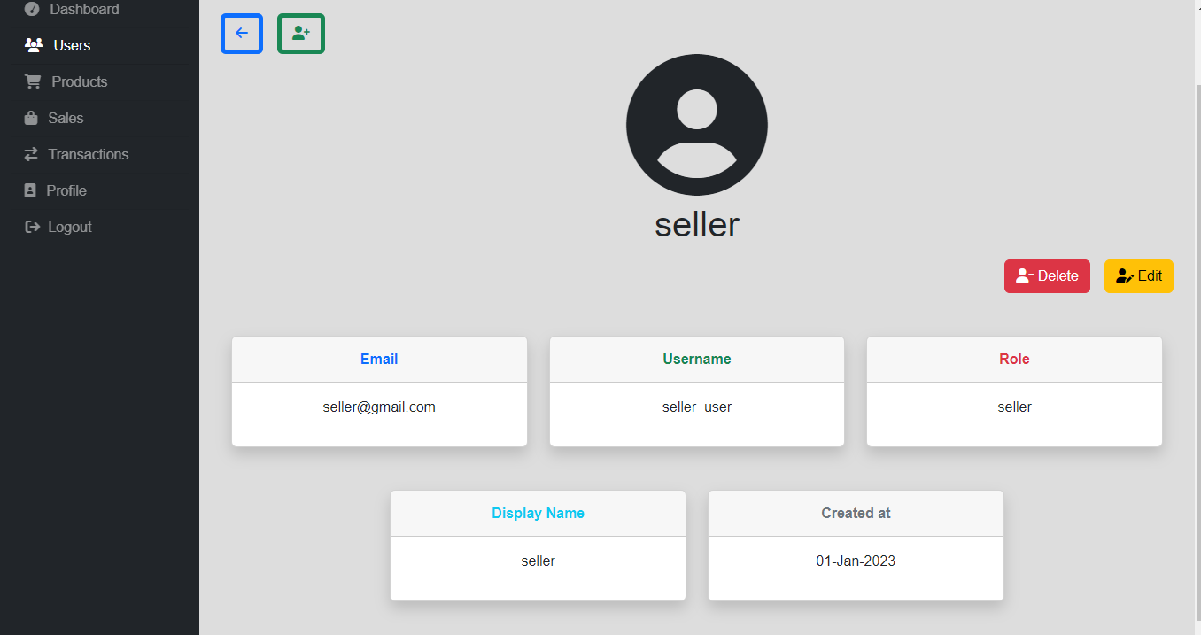
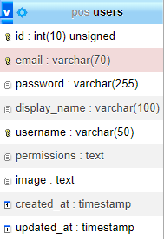
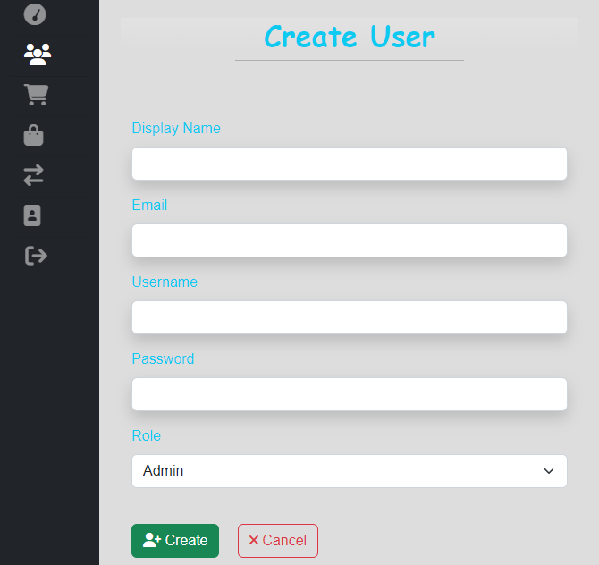
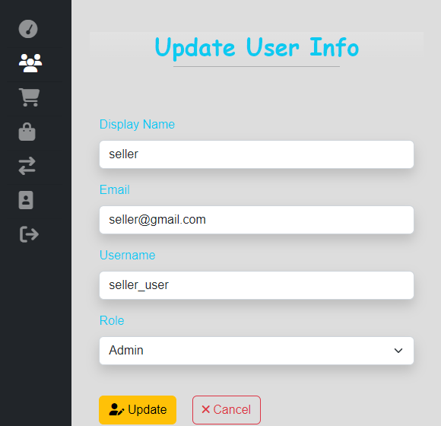
Users management pages (GUI)
Single user details
Users List page
User attributes
default: null
Add new user
Update user info
Notes:
Here is the users management pages the admin can access these page to show all users, add new users to the system or update delete user. Each user has … (columns, fields, attributes )in the db, the image is not required if the user doesn’t upload a profile photo; the profile icon will appear

Slide 18

Security Side of HTU-POS
The POS web application provides businesses with a secure and reliable platform to manage their operations by keeping them protected from various security vulnerabilities.
Cross-site scripting (XSS): is a type of security vulnerability that can be found in some web applications. XSS attacks enable attackers to inject client-side scripts into web pages viewed by other users. A cross-site scripting vulnerability may be used by attackers to bypass access controls.
SQL injection attacks: is a code injection technique used to attack data-driven applications, in which malicious SQL statements are inserted into an entry field for execution. Successful SQLi attacks allow attackers to modify database information, access sensitive data, execute admin tasks on the database, and recover files from the system. In some cases attackers can issue commands to the underlying database operating system.
Passwords are not easy to read: All passwords in this web app are hashed and encrypted via the strongest encryption algorithms. Nobody can see your password even admin.
All forms in this web app have both front-end and back-end validation.
Notes:
.(In short, xss attacks enable the hacker to write javascript code in your web application.)

Slide 19

Conclusion
POS web applications provide businesses with a comprehensive suite of features to help streamline and simplify their operations. They provide businesses with the ability to automate mundane tasks, track customer data, and manage inventory. Additionally, POS web application provide businesses with valuable insights into customer behavior and sales trends.
POS web application also provide businesses with the ability to customize the software to meet their specific needs. By using a POS web application, businesses can increase their efficiency and profitability.

Slide 20

Thank You!

